Slide 1
DS1_C4_S3_TASK10

Slide 2
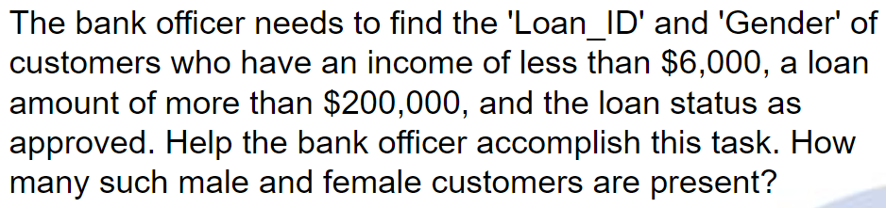
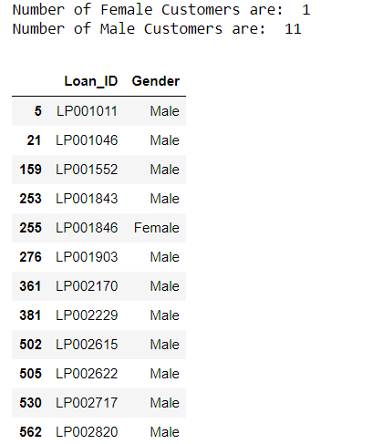
TASK 1
Output:
Interpretation
With the help of three filters on loan amount, Applicant income and approval status I got the DataFrame of desired customers then instead of using count() function I used shape() function to get the number of male and female customers

Slide 3
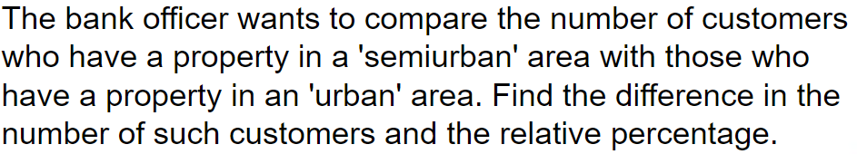

TASK 2
Output:
Interpretation
To accomplish this task I used filter on property area I got the DataFrame of desired customers and I used shape() function to get the number of customers from Urban and Rural area Customers and then I find the difference and RPD of such customers

Slide 4

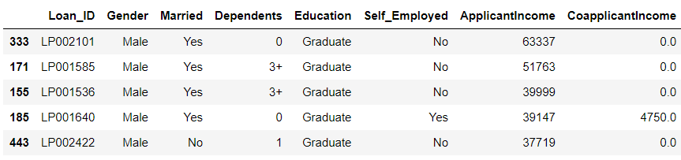
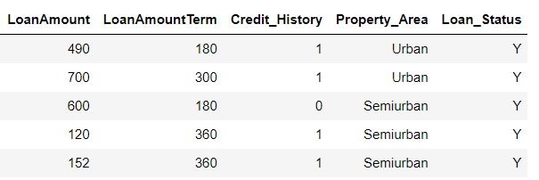
TASK 3
Output:
Interpretation:
To accomplish this task I used filter on loan Status I got the DataFrame of desired customers and then I used sort function to with ascending=‘False’ to sort the dataframe and the I used head() function to get top five results

Slide 5

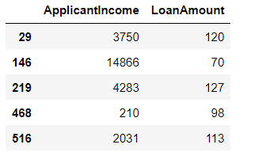
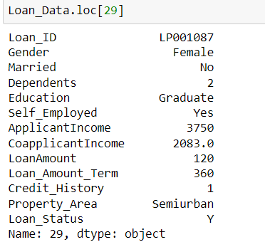
TASK 4
Output:
To verify the result
Interpretation:
To accomplish this task I simply used filter on loan Status, Dependents and Gender I got the DataFrame of desired customers and lastly I used loc() function to cross check the result

Slide 6
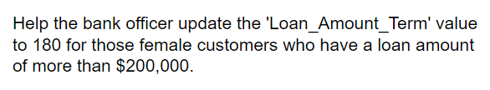
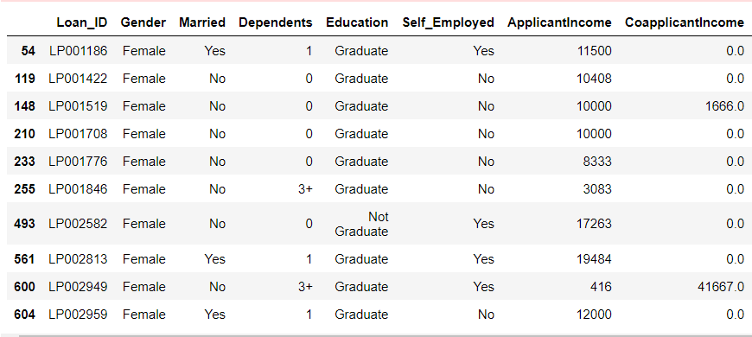
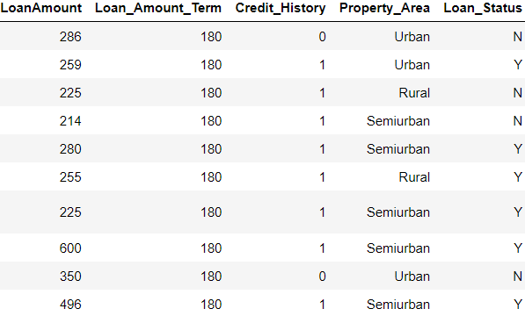
TASK 5
Output:
Interpretation:
To accomplish this task I simply used filter on Gender and LoanAmount I got the DataFrame of desired customers and then I replace the column value with 180

Slide 7

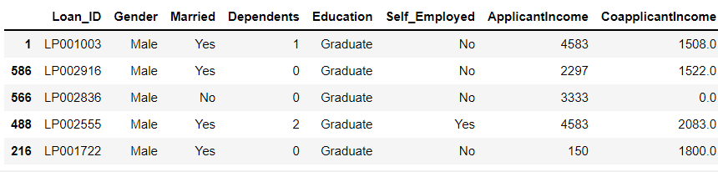
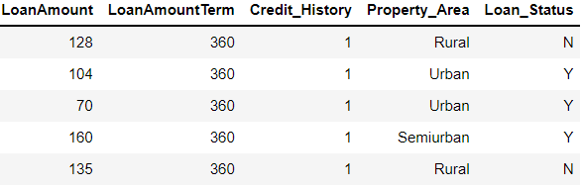
TASK 6
Output:
Interpretation:
To accomplish this task First I renamed 'Loan_Amount_Term':'LoanAmountTerm’ using rename() function then replace [12,36] with 60 with the help of replace() function and lastly I used sample function to get 5 results from DataFrame

Slide 8
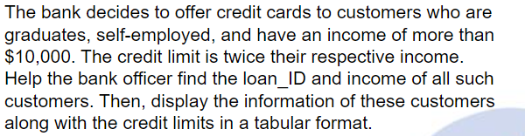
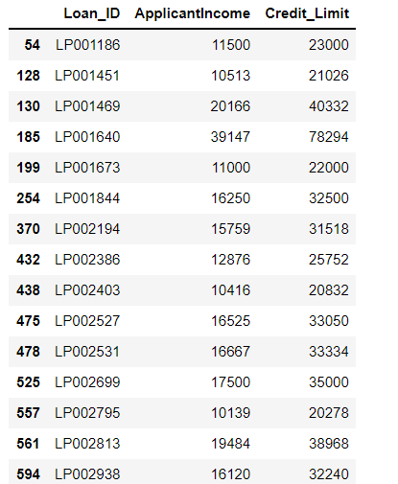
TASK 7
Output:
Interpretation:
To accomplish this I used filters
Self Employed, Education and Income
Then created a dataframe called Customer_DF where I stored the data of 'Loan_ID’ and 'ApplicantIncome’
Then I created a series called Credit_limit changed Its name as ‘Credit_limit’ and then to get the desired result I merged both Customer_DF DataFrame and Credit_limit Series using Concate() Function

Slide 9

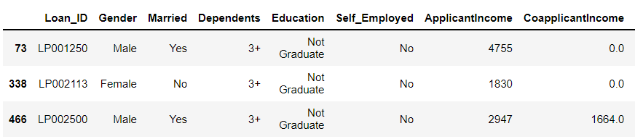
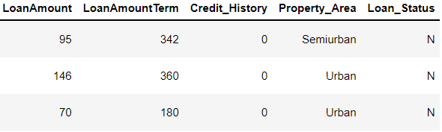
TASK 8
Output:
Interpretation:
To accomplish this I used filters on Credit History, Education and Dependents to get the desired datafram and the from main DataFrame i.e. ‘Loan_Data’ I deleted thos rows with the help of Drop Function and finally we don’t have that record in our Main Data Frame which can be confirmed in second snap.

Slide 10
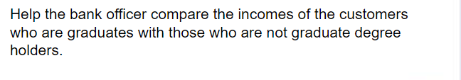
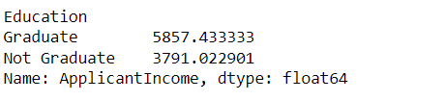
TASK 9
Output:
Interpretation:
To accomplish this I used filters I used groupby () function on Education column and mean of Applicant Income to get the desired result

